Slide 1
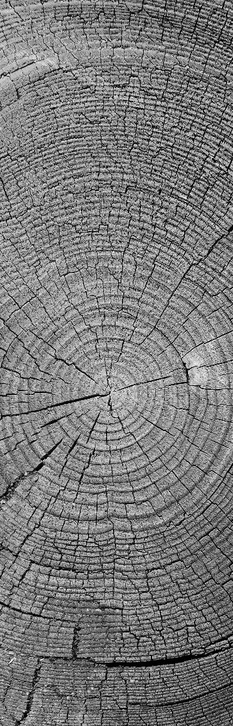
Methods in digital IMAGE steganography
CSE/ECE 478 Digital Image Processing Project
By
Kiruthika Kannan - 2018702001
Ritu Srivatsava - 2018701002

Slide 2

Project Details
Project Id | 13
Title | Methods in digital steganography
Team Members | Kiruthika Kannan | 2018702001 | kiruthika.k@research.iiit.ac.in
 | Ritu Srivatsava | 2018701002 | ritu.srivatsava@research.iiit.ac.in
Github Link | https://github.com/kiruthika-kannan/Steganography.git

Slide 3

Problem definition
To efficiently conceal an image in an image such that the hidden data (payload image) in the stego-image is imperceptible to human vision system. The primary goal is to maximize the amount of information hidden while keeping the noticeable difference to a minimum

Slide 4

Main goals of the project
Exploring
Implementing
Evaluating
different methods of digital image steganography.

Slide 5
Overview of digital image steganography
Cover Image
EMBEDDING PROCESS
Stego Image
Payload Image
Communication channel
Extracted Cover Image
Stego Image
EXTRACTION PROCESS
Extracted Payload Image

Slide 6
Content
Least Significant Bit (LSB) substitution
Edge image based steganography
Bit plane complexity based steganography
Exploiting Modification Direction (EMD)
Sparse pixels from histogram and Euclidean distance Measure in spatial domain
Pixel Value Differencing (PVD) based steganography
Discrete Cosine Transform

Slide 7
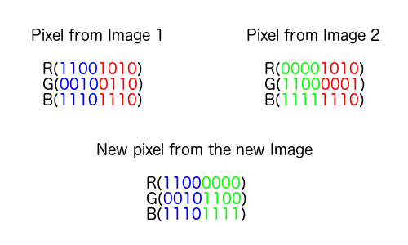
Least Significant Bit (LSB) substitution
Cover Image
Payload Image
n Most Significant Bits
(8-n) Least Significant Bits
Stego Image
n Most Significant Bits
(8-n) Least Significant Bits
Extracted Cover Image
Extracted Payload Image

Slide 8
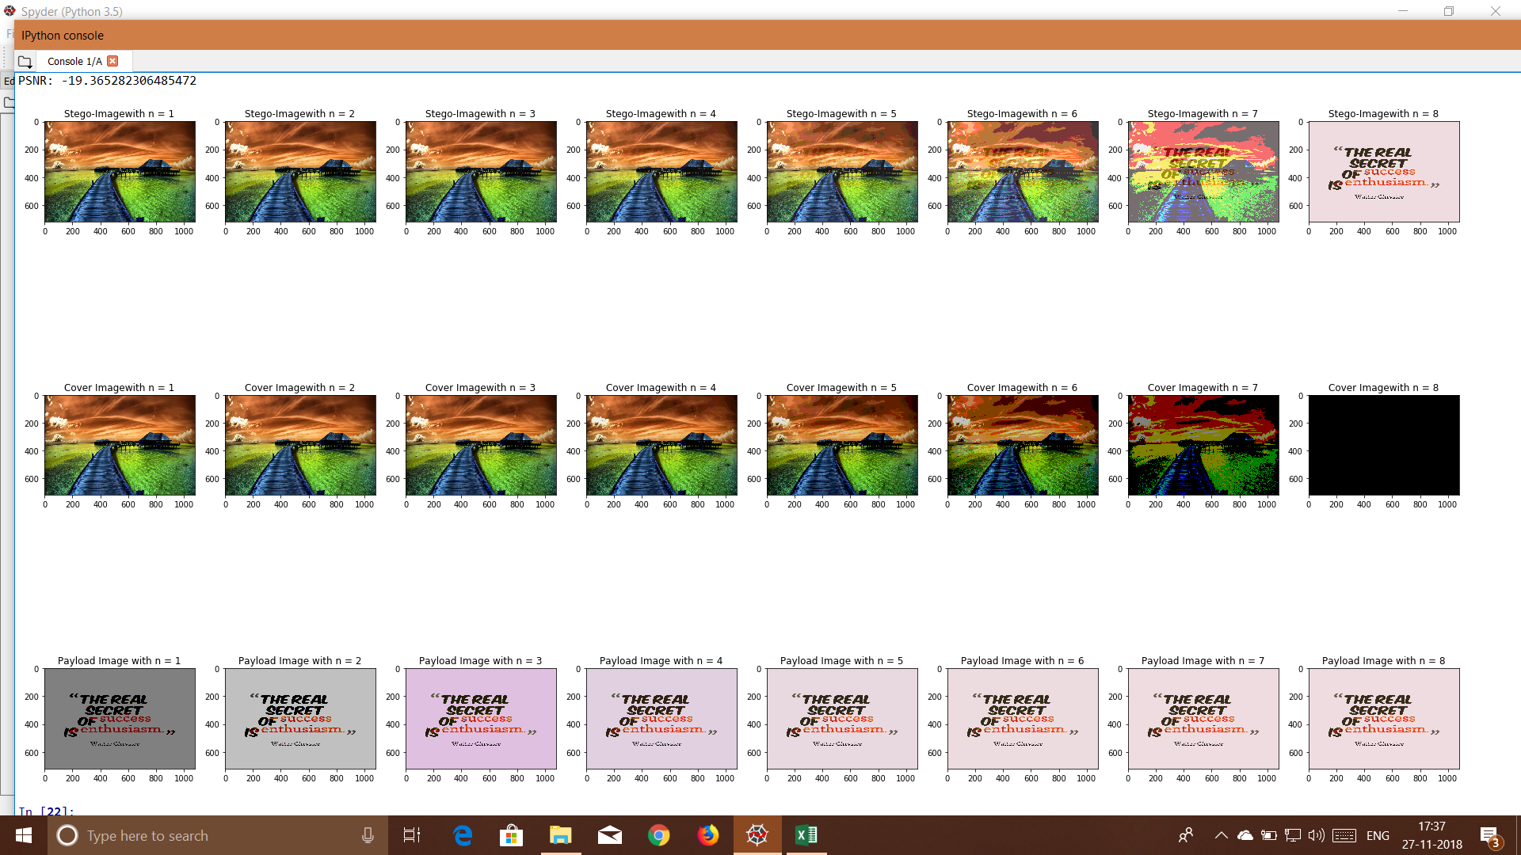
Least Significant Bit (LSB) substitution

Slide 9
Least Significant Bit (LSB) substitution
LSB substitution is the simplest method.
But it does not take into account the characteristics of cover or payload image.
Both embedding and extraction algorithms must know the value of n.
Increasing the number of bits n decreases the visual quality of stego-image.
No. of replace bits | PSNR | MSE
3 | 36.12 | 15.88
4 | 29.646 | 70.54
5 | 27.794 | 108.04
6 | 27.55 | 114.27

Slide 10

Content
Least Significant Bit (LSB) substitution
Edge image based steganography
Bit plane complexity based steganography
Exploiting Modification Direction (EMD)
Sparse pixels from histogram and Euclidean distance Measure in spatial domain
Pixel Value Differencing (PVD) based steganography
Discrete Cosine Transform

Slide 11
Edge image based steganography
Cover Image
Edge Image
Payload Image
Stego Image
No. of replace bits m
Embedding status data
m Most Significant Bits
(8-m) Least Significant Bits
(8-m) Least Significant Bits
m Most Significant Bits
No. of replace bits m
Embedding status data
Extracted Cover Image
Extracted Payload Image
Stego Image

Slide 12
Edge image based steganography

Slide 13
Edge image based steganography

Slide 14
Content
Least Significant Bit (LSB) substitution
Edge image based steganography
Bit plane complexity based steganography
Exploiting Modification Direction (EMD)
Sparse pixels from histogram and Euclidean distance Measure in spatial domain
Pixel Value Differencing (PVD) based steganography
Discrete Cosine Transform

Slide 15
Bit plane complexity

Slide 16
Bit plane complexity based steganography
Cover Image
Payload Image
Divide into nxn blocks
Divide into nxn blocks
Compute BPC of each bit plane
Compute BPC of each bit plane
Compute number of bits to replace ‘m’
If BPCS < threshold
Get (8-‘m’) most significant bits
Get ‘m’ least significant bits
Compute complexity conjugate of the plane
Compute conjugation map
Embed
Stego Image

Slide 17
Bit plane complexity based steganography
Stego Image
Compute conjugation map
Divide into nxn blocks
Compute BPC of each bit plane
Get (8-‘m’) least significant bits
Compute number of bits to replace ‘m’
Get ‘m’ most significant bits
Compute complexity conjugate of the plane
Cover Image
Payload Image

Slide 18
Bit plane complexity based steganography

Slide 19
Bit plane complexity based steganography

Slide 20
Content
Least Significant Bit (LSB) substitution
Edge image based steganography
Bit plane complexity based steganography
Exploiting Modification Direction (EMD)
Sparse pixels from histogram and Euclidean distance Measure in spatial domain
Pixel Value Differencing (PVD) based steganography
Discrete Cosine Transform

Slide 21
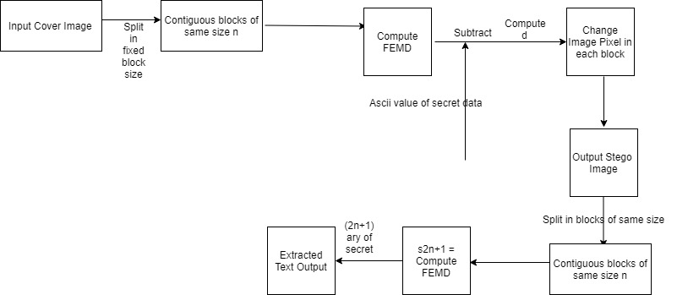
Exploiting Modification Direction (EMD)

Slide 22
Exploiting Modification Direction (EMD)

Slide 23
Exploiting Modification Direction (EMD)

Slide 24
Content
Least Significant Bit (LSB) substitution
Edge image based steganography
Bit plane complexity based steganography
Exploiting Modification Direction (EMD)
Sparse pixels from histogram and Euclidean distance Measure in spatial domain
Pixel Value Differencing (PVD) based steganography
Discrete Cosine Transform

Slide 25
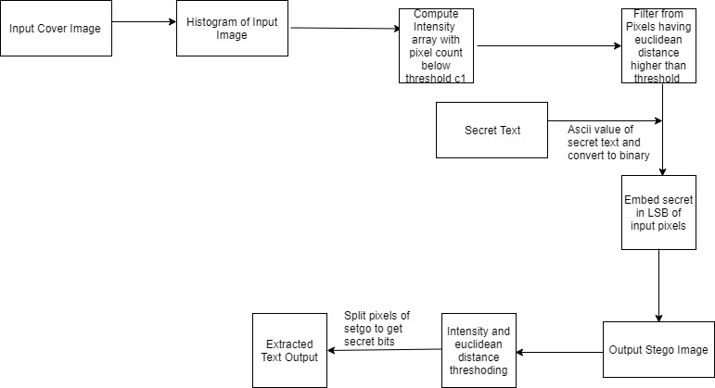
Sparse pixels from histogram and Euclidean distance Measure in spatial domain

Slide 26
Sparse pixels from histogram and Euclidean distance Measure in spatial domain

Slide 27
Sparse pixels from histogram and Euclidean distance Measure in spatial domain

Slide 28
Content
Least Significant Bit (LSB) substitution
Edge image based steganography
Bit plane complexity based steganography
Exploiting Modification Direction (EMD)
Sparse pixels from histogram and Euclidean distance Measure in spatial domain
Pixel Value Differencing (PVD) based steganography
Discrete Cosine Transform

Slide 29
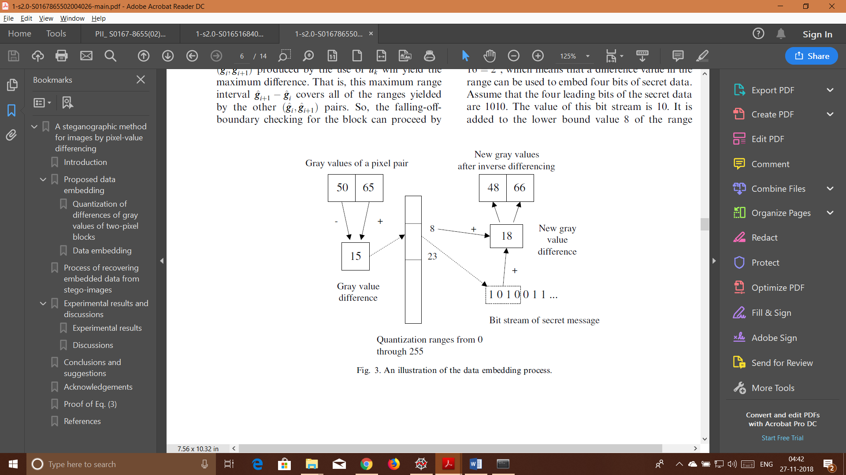
Pixel Value Differencing (PVD) based steganography

Slide 30
Pixel Value Differencing (PVD) based steganography

Slide 31
Pixel Value Differencing (PVD) based steganography

Slide 32
Content
Least Significant Bit (LSB) substitution
Edge image based steganography
Bit plane complexity based steganography
Exploiting Modification Direction (EMD)
Sparse pixels from histogram and Euclidean distance Measure in spatial domain
Pixel Value Differencing (PVD) based steganography
Discrete Cosine Transform

Slide 33
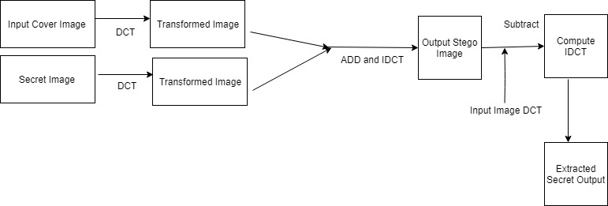
Discrete Cosine Transform

Slide 34
Discrete Cosine Transform

Slide 35
Discrete Cosine Transform

Slide 36

Results of the project
Stego-image output using different method of steganography for image in image embedding.
Comparison of the different methods.

Slide 37
Future work and conclusion

Slide 38
tasks
Ritu
Kiruthika
Steganography methods using
Discrete cosine transform
Exploiting Modification Direction (EMD)
Sparse pixels from histogram and Euclidean distance Measure
Steganography methods using
Least significant bit substitution
Edge detection
Bit plane complexity
Pixel Value Difference
2018701002
ritu.srivatsava@research.iiit.ac.in
2018702001
kiruthika.k@research.iiit.ac.in

Slide 39

Questions

Slide 40
Thank you
Kiruthika Kannan - 2018702001
Ritu Srivatsava - 2018701002

